Slide 1

Computer Architecture
A Quantitative Approach
Chapter 3 and Appendix C
Dynamic Scheduling

Slide 2

Review Question
Suppose that
  Suppose we have a memory hierarchy with 2 levels of cache and also for simplicity suppose that all memory accesses are READ accesses.
  L1 cache hit time is 2 ns
  L2 cache hit time is 10 ns
  Memory access time is 100 ns
  L1 cache miss rate is 8%
  L2 cache miss rate is 1% of the instructions that have L1 cache miss
Choose the range that includes the AMAT (average memory access time) of the memory system above.
[2, 3)
[3, 6)
[6, 10)
None of the above
Notes:
>>
AMAT = L1 hit time + L1 miss rate * L1 miss penalty
L1 hit time: 2ns
L1 miss rate: 8%
L1 miss penalty = L2 hit time + L2 miss rate * L2 miss penalty
L2 hit time: 10ns
L2 miss rate: 1% (of L1 misses)
L2 miss penalty = Memory access time = 100ns
L1 miss penalty = 10ns + 0.01 * 100ns = 11ns
AMAT = 2ns + 0.08 * 11ns = 2.88ns
The answer is A.

Slide 3
Review Question
Suppose that
  We have a processor with a 128KB,
  2-way set-associative cache with 64-byte block size
  A program repeatedly (lots of iterations) accesses only elements in the two cache blocks A and B.
  Assume 1 cycle hit time
  Assume memory access time takes 200 cycles
Compute AMAT while the program is running.
1
2.5
5
6
Notes:
>>
AMAT = Cache hit time + Cache miss rate + Cache miss penalty
Cache hit time: 1 cycle
Cache miss rate: 0%
Cache miss penalty = Memory access time = 200 cycles
AMAT = 1 cycle
Answer is A.

Slide 4
Outline
ILP – Instruction Level Parallelism
Compiler techniques to increase ILP
Loop Unrolling
Static Branch Prediction
Dynamic Branch Prediction
Overcoming Data Hazards with Dynamic Scheduling
(Start) Tomasulo Algorithm
Conclusion
4

Slide 5
Dynamically Scheduled Pipelines (Scoreboard)
A hardware technique that can do a good job of scheduling, since it has "perfect information" about hazards
Basic idea is to start each instruction as early as possible
  Analogy: waiting for a table at a restaurant
  Must deal with instructions that complete out-of-order
There is a lot to keep track of, and two main schemes to do the bookkeeping
  Scoreboard method (App. C.7)
  Tomasulo's method (Ch 3)
Notes:
>>
Scoreboarding is a hardware technique used for dynamic instruction scheduling that
enables out-of-order execution by tracking data dependencies and hazards in real time.
Since this technique has “perfect information” about hazards, it can do a good job of scheduling.
Goal:
Start each instruction as early as possible and deal with instructions that complete out-of-order.
Optional: (Give the analogy)
Main Schemes:
Scoreboard method (App. C.7)
and Tomasulo's method (Ch 3)
For reference:
Out-of-order execution allows a processor to execute instructions in a different order than they appear in the code,
while out-of-order completion refers to a situation where an instruction finishes executing before an earlier one
The scoreboard achieves its goal (starting instructions early and dealing with out-of-order completion)
by using its mechanism (tracking dependencies and enabling dynamic, out-of-order execution).
In essence, the second statement is the driving force behind the first.
The hardware technique (Scoreboarding) was developed specifically
to achieve the goal of maximizing Instruction Level Parallelism (ILP)
by executing instructions as soon as their data dependencies are met,
which necessitates out-of-order execution and completion.

Slide 6
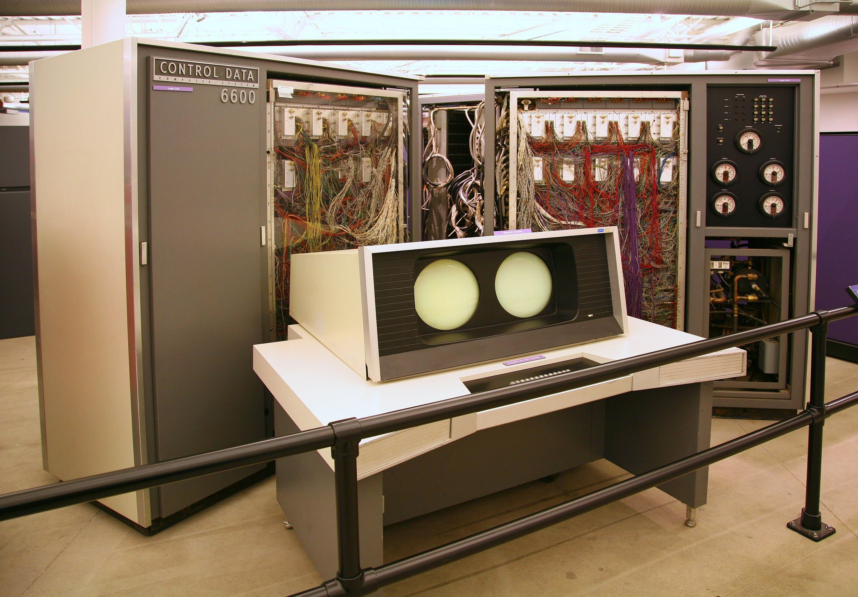
CDC6600
6
Notes:
>>
(CDC 6600, late 1960s)
Origin of Scoreboard Method: CDC 6600, late 1960s.
The CDC 6600 is the
flagship of the discontinued 6000 series
of mainframe computer systems
manufactured by Control Data Corporation,
and is widely regarded as the first successful supercomputer.

Slide 7

Scoreboard method
An example
Origins: CDC 6600, late 1960s
Scoreboard controls the progress of each instruction to ensure that hazards such as RAW, etc. are avoided
ID basic pipeline stage split into 2 stages
  Issue (IS) – decode instructions, check for structural and WAW hazards
  Read operands (RO) – wait until no data hazards, then FU reads operands
Distinguish when instruction begins execution and when
completes execution – in between it is in execution
All instructions pass through issue stage in order, but can stall or bypass each other in second stage
  So can get WAR hazards when instructions execute out of order
  To have multiple instructions in EX stage simultaneously,
  use multiple functional units, or pipelined units, or both –
  equivalent for purposes of pipeline control
Notes:
>>
Origin of Scoreboard Method: CDC 6600, late 1960s.
(You may refer to slide 6.)
(arrow down)
Scoreboard controls instruction flow to avoid RAW (Read-After-Write) and other hazards.
(arrow down)
ID (decode) Stage is Split:
Issue: Decodes, checks for structural and WAW (Write-After-Write) hazards.
Read operands: Waits until no data hazards, then reads operands.
(arrow down)
Instructions are issued in order,
but execute out-of-order,
which can lead to WAR (Write-After-Read) hazards.
(arrow down)
An example …
Potentially, ADD.D could write to F1 before MUL.D reads F1.

Slide 8

An example
Second MUL.D cannot be issued because of structural hazard (assuming only 1 multiply unit)
It is possible that ADD.D can write to F1 before MUL.D read F1 if we allow ADD.D to continue
Q. But what if ADD.D write into F6?
A. It can continue before the second MUL.D
Notes:
>>
Also, the second MUL.D cannot be issued
if there is only 1 multiply functional unit,
leading to a structural hazard.
(arrow down)
…

Slide 9
Functional Units in Scoreboarding
Assume that processor has various functional units
  1 INT ALU (for memory ref, branch, integer ops),
  2 FP multiply units,
  1 FP adder unit, and
  1 FP divide unit
Idea is to try to keep all of the units busy
CDC6600
  4 FP units, 5 memory units, 7 ALU
On MIPS,
  Scoreboard makes sense primarily on the FP unit. Why?
Notes:
>>
One Example:
Assumed FUs: 1 INT ALU, 2 FP Multiply, 1 FP Adder, 1 FP Divide.
(Refer to figure in slide 10 and then come back.)
The aim is to keep functional units (FUs) busy.
On MIPS, scoreboard is most useful for the Floating-Point (FP) unit.
Q. Why?
A.
Using scoreboard to manage the Floating Point (FP) units on MIPS makes sense
due to the variable and often long latencies of floating-point operations
compared to the predictable, single-cycle latency of most integer operations.

Slide 10
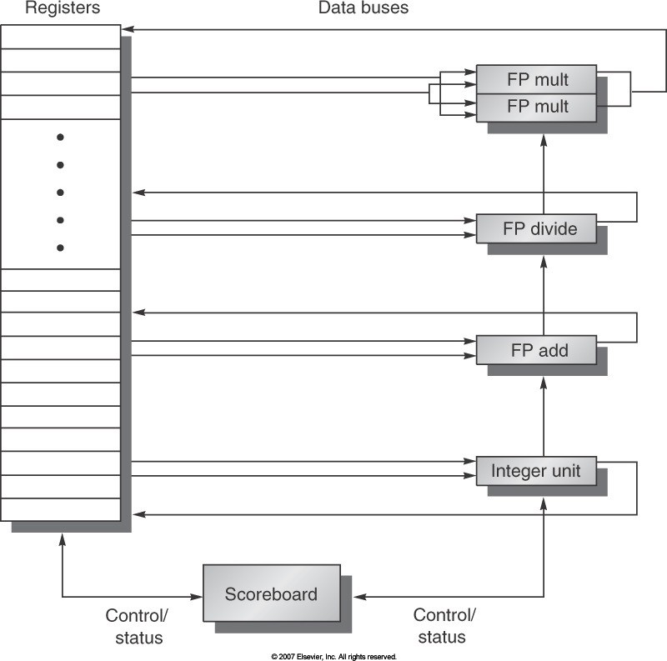
Basic MIPS Structure with a Scoreboard
Notes:
>>
This diagram depicts
a MIPS processor with a scoreboard that
combines the classic RISC architecture with dynamic scheduling
to enable in-order issue, out-of-order execution, and out-of-order completion.
Key Components
Functional Units (FUs):
Multiple parallel units (e.g., integer, FP adder, FP multiplier, FP divider, memory).
Register File:
Holds general-purpose and floating-point registers.
Scoreboard:
Central hardware unit that tracks instruction progress and resolves hazards.
(Return to slide 9.)

Slide 11
Scoreboard: Instruction Status Table
One segment of the scoreboard keeps track of which pipe stage each instruction is in – Fig. C.55
Instruction | Issue | Read operands | Execution complete | Write result
L.D F6,34(R2) | x | x | x | x
L.D F2, 45(R3) | x | x | x
MUL.D F0,F2,F4 | x
SUB.D F8,F6,F2 | x
DIV.D F10,F0,F6 | x
ADD.D F6,F8,F2
Instruction Status Table
Notes:
>>
Components of the scoreboard:
Each instruction that has issued or is pending issue has an entry in the instruction status table.
There is one entry in the functional unit status table for each functional unit.
---------------------
Optional: (have not covered yet)
Once an instruction issues, the record of its operands is kept in the functional unit status table.
Finally, the register result table indicates which unit will produce each pending result;
the number of entries is equal to the number of registers.
---------------------
The instruction status table says that:
the first L.D has completed and written its result, and
the second L.D has completed execution but has not yet written its result.
The MUL.D, SUB.D, and DIV.D have all issued but are stalled, waiting for their operands.

Slide 12
Scoreboard: Functional Unit Status
One segment of the scoreboard keeps track of,
for each functional unit:
  Busy (yes or no)
  Op: operation to perform
  Fi: name of destination register
  Fj, Fk: names of source registers
  Qj, Qk: functional units producing the sources Fj and Fk.
  Rj, Rk: ready flags when Fj and Fk are ready and unread:
» "yes" if the source is ready and still need it
» "no" if the source is not ready, or if no longer need it
Notes:
>>
The scoreboard tracks the status of each functional unit with the following fields:
… (Go over each field) …

Slide 13
Scoreboard: Functional Unit Status
Name | Busy | Op | Fi | Fj | Fk | Qj | Qk | Rj | Rk
Integer | Yes | Load | F2 | R3 |  |  |  | No
Mult1 | Yes | Mult | F0 | F2 | F4 | Integer |  | No | Yes
Mult2 | No
Add | Yes | Sub | F8 | F6 | F2 |  | Integer | Yes | No
Divide | Yes | Div | F10 | F0 | F6 | Mult1 |  | No | Yes
Fi: name of destination register
Fj, Fk: names of source registers
Qj, Qk: functional units producing the sources Fj and Fk
Rj, Rk: ready flags when Fj and Fk are ready and unread
Notes:
For reference:
Fi: name of destination register
Fj, Fk: names of source registers
Qj, Qk: functional units producing the sources Fj and Fk. (other instructions)
Rj, Rk: ready flags when Fj and Fk are ready and unread:

Slide 14
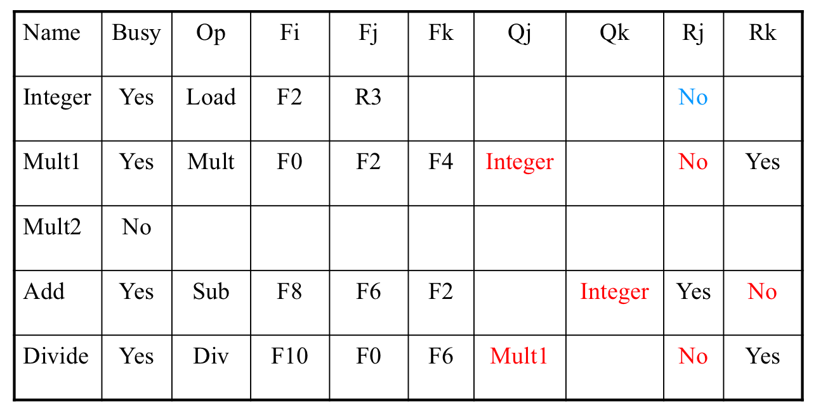
Register Status
One segment of the scoreboard keeps track of which registers are expecting outputs from which functional units
 | F0 | F2 | F4 | F6 | F8 | F10 | F12 | … | F30
FU | Mult1 | Integer |  |  | Add | Divide
Next, an example of the scoreboard method
Notes:
>>
Register Status:
Tracks which register is expecting an output from which functional unit.
For reference:
Fi: name of destination register
Fj, Fk: names of source registers
Qj, Qk: functional units producing the sources Fj and Fk. (other instructions)
Rj, Rk: ready flags when Fj and Fk are ready and unread:

Slide 15
Scoreboard Bookkeeping
Each functional unit keeps track of:
Unit | Opn | Fj | Fk | Qj | Qk
For our convenience, we’ll also indicate:
Inst
Stage
And we’ll assume these initial register contents and flags:
F0 | F2 | F4 | F6 | F8 | F10 | F12 | F14
0 | 3 | 4 | 6 | 8 | 10 | 12 | 14
0 | 0 | 0 | 0 | 0 | 0 | 0 | 0
Notes:
…
And we’ll assume these initial registers contents are flags:
The scoreboard uses a naming convention
to track which functional unit will write a result to a register.
For reference:
Fi: name of destination register
Fj, Fk: names of source registers
Qj, Qk: functional units producing the sources Fj and Fk. (other instructions)
Rj, Rk: ready flags when Fj and Fk are ready and unread:

Slide 16
Scoreboard – Initial State
Mult1 | x | x | x | x | x
Mult2 | x | x | x | x | x
x
x
x
x
Add1 | x | x | x | x | x
Add2 | x | x | x | x | x
x
x
x
x
F0 | F2 | F4 | F6 | F8 | F10 | F12 | F14
0 | 3 | 4 | 6 | 8 | 10 | 12 | 14
0 | 0 | 0 | 0 | 0 | 0 | 0 | 0
Notes:
Example 1
For reference:
Fi: name of destination register
Fj, Fk: names of source registers
Qj, Qk: functional units producing the sources Fj and Fk. (other instructions)
Rj, Rk: ready flags when Fj and Fk are ready and unread:

Slide 17
Time 0
S1: ADD.D F0, F2, F4
S1: ADD.D F0, F2, F4
Assume 2 cycle add
Mult1 | x | x | x | x | x
Mult2 | x | x | x | x | x
x
x
x
x
Add1 | Add.d | 3 | 4 | 0 | 0
Add2 | x | x | x | x | x
S1
Issue
x
x
F0 | F2 | F4 | F6 | F8 | F10 | F12 | F14
0 | 3 | 4 | 6 | 8 | 10 | 12 | 14
a1 | 0 | 0 | 0 | 0 | 0 | 0 | 0
Notes:
For reference:
Fi: name of destination register
Fj, Fk: names of source registers
Qj, Qk: functional units producing the sources Fj and Fk. (other instructions)
Rj, Rk: ready flags when Fj and Fk are ready and unread:

Slide 18
S1: ADD.D F0, F2, F4 S2: MULT.D F2, F6, F8
Time 1
S2: MULT.D F2, F6, F8
Assume 4 cycle mult
Mult1 | Mult.d | 6 | 8 | 0 | 0
Mult2 | x | x | x | x | x
S2
Issue
x
x
Add1 | Add.d | 3 | 4 | 0 | 0
Add2 | x | x | x | x | x
S1
Exec1
x
x
F0 | F2 | F4 | F6 | F8 | F10 | F12 | F14
0 | 3 | 4 | 6 | 8 | 10 | 12 | 14
a1 | m1 | 0 | 0 | 0 | 0 | 0 | 0
Notes:
For reference:
Fi: name of destination register
Fj, Fk: names of source registers
Qj, Qk: functional units producing the sources Fj and Fk. (other instructions)
Rj, Rk: ready flags when Fj and Fk are ready and unread:

Slide 19
S1: ADD.D F0, F2, F4
S2: MULT.D F2, F6, F8 S3: MULT.D F10, F0, F2
Time 2
S3: MULT.D F10, F0, F2
Mult1 | Mult.d | 6 | 8 | 0 | 0
Mult2 | Mult.d | x | x | a1 | m1
S2
Exec1
S3
Issue
Add1 | Add.d | 3 | 4 | 0 | 0
Add2 | x | x | x | x | x
S1
Exec2
x
x
F0 | F2 | F4 | F6 | F8 | F10 | F12 | F14
0 | 3 | 4 | 6 | 8 | 10 | 12 | 14
a1 | m1 | 0 | 0 | 0 | m2 | 0 | 0
Notes:
>>
S3:
RAW: S1-S3 on F0
RAW: S2-S3 on F2
(Stall S3)
For reference:
Fi: name of destination register
Fj, Fk: names of source registers
Qj, Qk: functional units producing the sources Fj and Fk. (other instructions)
Rj, Rk: ready flags when Fj and Fk are ready and unread:

Slide 20
S1: ADD.D F0, F2, F4
S2: MULT.D F2, F6, F8 S3: MULT.D F10, F0, F2
Time 3
S4: ADD.D F0, F8, F6
S4: ADD.D F0, F8, F6
Mult1 | Mult.d | 6 | 8 | 0 | 0
Mult2 | Mult.d | x | x | 0 | m1
S2
Exec2
S3
Issue
Add1 | Add.d | 3 | 4 | 0 | 0
Add2 | Add.d | 8 | 6 | 0 | 0
S1
Write
S4
Issue
No structural or WAW hazard!
F0 | F2 | F4 | F6 | F8 | F10 | F12 | F14
7 | 3 | 4 | 6 | 8 | 10 | 12 | 14
a2 | m1 | 0 | 0 | 0 | m2 | 0 | 0
To m2, but F0 not really nec.
Notes:
>>
S4:
No WAW: S1-S4 on F0
Because S1 is in the write stage,
no WAW hazard will occur with S4 on F0.
No structural hazard (2 FP adder FUs)
For reference:
Fi: name of destination register
Fj, Fk: names of source registers
Qj, Qk: functional units producing the sources Fj and Fk. (other instructions)
Rj, Rk: ready flags when Fj and Fk are ready and unread:

Slide 21
Time 4
S1: ADD.D F0, F2, F4 S2: MULT.D F2, F6, F8 S3: MULT.D F10, F0, F2 S4: ADD.D F0, F8, F6 S5: ADD.D F4, F6, F6
S5: ADD.D F4, F6, F6
Mult1 | Mult.d | 6 | 8 | 0 | 0
Mult2 | Mult.d | x | x | 0 | m1
S2
Exec3
S3
Issue
Add1 | Add.d | 6 | 6 | 0 | 0
Add2 | Add.d | 8 | 6 | 0 | 0
S5
Issue
S4
Exec1
F0 | F2 | F4 | F6 | F8 | F10 | F12 | F14
7 | 3 | 4 | 6 | 8 | 10 | 12 | 14
a2 | m1 | a1 | 0 | 0 | m2 | 0 | 0
Notes:
For reference:
Fi: name of destination register
Fj, Fk: names of source registers
Qj, Qk: functional units producing the sources Fj and Fk. (other instructions)
Rj, Rk: ready flags when Fj and Fk are ready and unread:

Slide 22
Time 5
S1: ADD.D F0, F2, F4 S2: MULT.D F2, F6, F8 S3: MULT.D F10, F0, F2 S4: ADD.D F0, F8, F6 S5: ADD.D F4, F6, F6
S6: ADD.D F2, F2, F6
S6: ADD.D F2, F2, F6
stalled
Mult1 | Mult.d | 6 | 8 | 0 | 0
Mult2 | Mult.d | x | x | 0 | m1
S2
Exec4
S3
Issue
Add1 | Add.d | 6 | 6 | 0 | 0
Add2 | Add.d | 8 | 6 | 0 | 0
S5
Exec1
S4
Exec2
F0 | F2 | F4 | F6 | F8 | F10 | F12 | F14
7 | 3 | 4 | 6 | 8 | 10 | 12 | 14
a2 | m1 | a1 | 0 | 0 | m2 | 0 | 0
Notes:
>>
RAW: S2-S6 on F2 (Stall S6)
For reference:
Fi: name of destination register
Fj, Fk: names of source registers
Qj, Qk: functional units producing the sources Fj and Fk. (other instructions)
Rj, Rk: ready flags when Fj and Fk are ready and unread:

Slide 23
Time 6
S1: ADD.D F0, F2, F4 S2: MULT.D F2, F6, F8 S3: MULT.D F10, F0, F2 S4: ADD.D F0, F8, F6 S5: ADD.D F4, F6, F6
S6: ADD.D F2, F2, F6
S6: ADD.D F2, F2, F6
stalled
S3: MULT.D F10, F0, F2
Mult1 | Mult.d | 6 | 8 | 0 | 0
Mult2 | Mult.d | 7 | 48 | 0 | 0
S2
Write
S2: MULT.D F2, F6, F8
S3
Issue
S5: ADD.D F4, F6, F6
S4: ADD.D F0, F8, F6
Add1 | Add.d | 6 | 6 | 0 | 0
Add2 | Add.d | 8 | 6 | 0 | 0
S5
Exec2
S4
Write
Stalled
WAR check! F_{j}[m2] = F_{i}[a2]
& R_{j}[m2]=Yes
F0 | F2 | F4 | F6 | F8 | F10 | F12 | F14
7 | 48 | 4 | 6 | 8 | 10 | 12 | 14
a2 | 0 | a1 | 0 | 0 | m2 | 0 | 0
Notes:
>>
WAR: S3-S4 on F0 (Stall S4)
S4 must stall due to WAR hazard with S3 on F0.
For reference:
Fi: name of destination register
Fj, Fk: names of source registers
Qj, Qk: functional units producing the sources Fj and Fk. (other instructions)
Rj, Rk: ready flags when Fj and Fk are ready and unread:

Slide 24
Time 7
S1: ADD.D F0, F2, F4 S2: MULT.D F2, F6, F8 S3: MULT.D F10, F0, F2 S4: ADD.D F0, F8, F6 S5: ADD.D F4, F6, F6
S6: ADD.D F2, F2, F6
S6: ADD.D F2, F2, F6
Mult1 | x | x | x | x | x
Mult2 | Mult.d | 7 | 48 | 0 | 0
x
x
S3
Exec1
S5: ADD.D F4, F6, F6
S4: ADD.D F0, F8, F6
Add1 | Add.d | 6 | 6 | 0 | 0
Add2 | Add.d | 8 | 6 | 0 | 0
S5
Write
stalled
S4
Write
F0 | F2 | F4 | F6 | F8 | F10 | F12 | F14
14 | 48 | 4 | 6 | 8 | 10 | 12 | 14
0 | 0 | a1 | 0 | 0 | m2 | 0 | 0
Notes:
>>
RAW: S2-S6 on F2 (Stall S6)
For reference:
Fi: name of destination register
Fj, Fk: names of source registers
Qj, Qk: functional units producing the sources Fj and Fk. (other instructions)
Rj, Rk: ready flags when Fj and Fk are ready and unread:

Slide 25
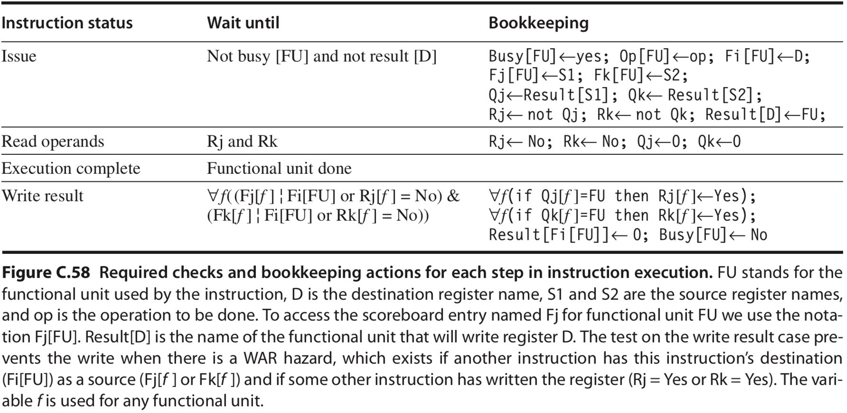
Again… Scoreboard Working Mechanism

Slide 26
Scoreboard Example #2 (Fig.C.55)
- after first L.D write result
Instruction Status Table
Inst. | issue | Read operands | Execution complete | Write result
L.D F6, 34(R2) | O | O | O | O
L.D F2, 45(R3) | O | O | O
MUL.D F0, F2, F4 | O
SUB.D F8, F6, F2 | O
DIV.D F10,F0, F6 | O
ADD.D F6, F8, F2
Functional Unit Status
Name | Busy | Op | Fi | Fj | Fk | Qj | Qk | Rj | Rk
Integer | Y | Load | F2 | R3 |  |  |  | N
Mult1 | Y | MUL.D | F0 | F2 | F4 | Integer |  | N | Y
Mult2 | N
Add | Y | SUB.D | F8 | F6 | F2 |  | Integer | Y | N
Divide | Y | DIV.D | F10 | F0 | F6 | Mult1 |  | N | Y
Register Status
 | F0 | F2 | F4 | F6 | F8 | F10 | F12 | .. | F30
FU | Mult1 | Integer |  |  | Add | Divide
26
Notes:
Example 2
after first L.D write result
For reference:
Fi: name of destination register
Fj, Fk: names of source registers
Qj, Qk: functional units producing the sources Fj and Fk. (other instructions)
Rj, Rk: ready flags when Fj and Fk are ready and unread:

Slide 27
Scoreboard Example #2 (cont.)
- after 2nd L.D write result
Instruction Status Table
Inst. | issue | Read operands | Execution complete | Write result
L.D F6, 34(R2) | O | O | O | O
L.D F2, 45(R3) | O | O | O | O
MUL.D F0, F2, F4 | O
SUB.D F8, F6, F2 | O
DIV.D F10,F0, F6 | O
ADD.D F6, F8, F2
Functional Unit Status
Name | Busy | Op | Fi | Fj | Fk | Qj | Qk | Rj | Rk
Integer (1 cc) | N | Load | F2 | R3 |  |  |  | N
Mult1 (10 cc) | Y | MUL.D | F0 | F2 | F4 | Integer |  | Y | Y
Mult2 (10 cc) | N
Add (2 cc) | Y | SUB.D | F8 | F6 | F2 |  | Integer | Y | Y
Divide (40 cc) | Y | DIV.D | F10 | F0 | F6 | Mult1 |  | N | Y
Register Status
 | F0 | F2 | F4 | F6 | F8 | F10 | F12 | .. | F30
FU | Mult1 | 0 |  |  | Add | Divide
27
Notes:
after 2nd L.D write result
For reference:
Fi: name of destination register
Fj, Fk: names of source registers
Qj, Qk: functional units producing the sources Fj and Fk. (other instructions)
Rj, Rk: ready flags when Fj and Fk are ready and unread:

Slide 28
Scoreboard Example #2 (cont.)
- after the write result, MUL.D and SUB.D read operands
Instruction Status Table
Inst. | issue | Read operands | Execution complete | Write result
L.D F6, 34(R2) | O | O | O | O
L.D F2, 45(R3) | O | O | O | O
MUL.D F0, F2, F4 | O | O
SUB.D F8, F6, F2 | O | O
DIV.D F10,F0, F6 | O
ADD.D F6, F8, F2
Functional Unit Status
Name | Busy | Op | Fi | Fj | Fk | Qj | Qk | Rj | Rk
Integer (1 cc) | N | Load | F2 | R3 |  |  |  | N
Mult1 (10 cc) | Y | MUL.D | F0 | F2 | F4 | 0 | 0 | N | N
Mult2 (10 cc) | N
Add (2 cc) | Y | SUB.D | F8 | F6 | F2 | 0 | 0 | N | N
Divide (40 cc) | Y | DIV.D | F10 | F0 | F6 | Mult1 |  | N | Y
Register Status
 | F0 | F2 | F4 | F6 | F8 | F10 | F12 | .. | F30
FU | Mult1 | 0 |  |  | Add | Divide
Notes:
after the write result, MUL.D and SUB.D read operands
For reference:
Fi: name of destination register
Fj, Fk: names of source registers
Qj, Qk: functional units producing the sources Fj and Fk. (other instructions)
Rj, Rk: ready flags when Fj and Fk are ready and unread:

Slide 29
Scoreboard Example #2 (cont.)
- after SUB.D write result
Instruction Status Table
Inst. | issue | Read operands | Execution complete | Write result
L.D F6, 34(R2) | O | O | O | O
L.D F2, 45(R3) | O | O | O | O
MUL.D F0, F2, F4 | O | O
SUB.D F8, F6, F2 | O | O | O | O
DIV.D F10,F0, F6 | O
ADD.D F6, F8, F2
Functional Unit Status
Name | Busy | Op | Fi | Fj | Fk | Qj | Qk | Rj | Rk
Integer (1 cc) | N | Load | F2 | R3 |  |  |  | N
Mult1 (10 cc) | Y | MUL.D | F0 | F2 | F4 | 0 | 0 | N | N
Mult2 (10 cc) | N
Add (2 cc) | N | SUB.D | F8 | F6 | F2 | 0 | 0 | N | N
Divide (40 cc) | Y | DIV.D | F10 | F0 | F6 | Mult1 |  | N | Y
Register Status
 | F0 | F2 | F4 | F6 | F8 | F10 | F12 | .. | F30
FU | Mult1 | 0 |  |  | 0 | Divide
29
Notes:
after SUB.D write result
(MUL.D is still executing)
For reference:
Fi: name of destination register
Fj, Fk: names of source registers
Qj, Qk: functional units producing the sources Fj and Fk. (other instructions)
Rj, Rk: ready flags when Fj and Fk are ready and unread:

Slide 30
Scoreboard Example #2 (cont.)
- after the write result, ADD.D is issued
Instruction Status Table
Inst. | issue | Read operands | Execution complete | Write result
L.D F6, 34(R2) | O | O | O | O
L.D F2, 45(R3) | O | O | O | O
MUL.D F0, F2, F4 | O | O
SUB.D F8, F6, F2 | O | O | O | O
DIV.D F10,F0, F6 | O
ADD.D F6, F8, F2 | O
Functional Unit Status
Name | Busy | Op | Fi | Fj | Fk | Qj | Qk | Rj | Rk
Integer (1 cc) | N | Load | F2 | R3 |  |  |  | N
Mult1 (10 cc) | Y | MUL.D | F0 | F2 | F4 | 0 | 0 | N | N
Mult2 (10 cc) | N
Add (2 cc) | Y | ADD.D | F6 | F8 | F2 | 0 | 0 | Y | Y
Divide (40 cc) | Y | DIV.D | F10 | F0 | F6 | Mult1 |  | N | Y
Register Status
 | F0 | F2 | F4 | F6 | F8 | F10 | F12 | .. | F30
FU | Mult1 | 0 |  | Add | 0 | Divide
Notes:
after the write result, ADD.D is issued
For reference:
Fi: name of destination register
Fj, Fk: names of source registers
Qj, Qk: functional units producing the sources Fj and Fk. (other instructions)
Rj, Rk: ready flags when Fj and Fk are ready and unread:

Slide 31
Scoreboard Example #2 (cont.)
- Just before MUL.D goes to write result
Instruction Status Table
Inst. | issue | Read operands | Execution complete | Write result
L.D F6, 34(R2) | O | O | O | O
L.D F2, 45(R3) | O | O | O | O
MUL.D F0, F2, F4 | O | O | O
SUB.D F8, F6, F2 | O | O | O | O
DIV.D F10,F0, F6 | O
ADD.D F6, F8, F2 (WAR on F6) | O | O | O
Functional Unit Status
Name | Busy | Op | Fi | Fj | Fk | Qj | Qk | Rj | Rk
Integer (1 cc) | N
Mult1 (10 cc) | Y | MUL.D | F0 | F2 | F4 |  |  | N | N
Mult2 (10 cc) | N
Add (2 cc) | Y | ADD.D | F6 | F8 | F2 |  |  | N | N
Divide (40 cc) | Y | DIV.D | F10 | F0 | F6 | Mult1 |  | N | Y
Register Status
 | F0 | F2 | F4 | F6 | F8 | F10 | F12 | .. | F30
FU | Mult1 |  |  | Add |  | Divide
Notes:
Just before MUL.D goes to write result
WAR hazard occurs between ADD.D and DIV.D on F6
For reference:
Fi: name of destination register
Fj, Fk: names of source registers
Qj, Qk: functional units producing the sources Fj and Fk. (other instructions)
Rj, Rk: ready flags when Fj and Fk are ready and unread:

Slide 32
Scoreboard Example #2 (cont.)
- Just before DIV.D goes to write result
Instruction Status Table
Inst. | issue | Read operands | Execution complete | Write result
L.D F6, 34(R2) | O | O | O | O
L.D F2, 45(R3) | O | O | O | O
MUL.D F0, F2, F4 | O | O | O | O
SUB.D F8, F6, F2 | O | O | O | O
DIV.D F10,F0, F6 | O | O | O
ADD.D F6, F8, F2 | O | O | O | O
Functional Unit Status
Name | Busy | Op | Fi | Fj | Fk | Qj | Qk | Rj | Rk
Integer (1 cc) | N
Mult1 (10 cc) | N
Mult2 (10 cc) | N
Add (2 cc) | N
Divide (40 cc) | Y | DIV.D | F10 | F0 | F6 |  |  | N | N
Register Status
 | F0 | F2 | F4 | F6 | F8 | F10 | F12 | .. | F30
FU |  |  |  |  |  | Divide
Notes:
Just before DIV.D goes to write result
For reference:
Fi: name of destination register
Fj, Fk: names of source registers
Qj, Qk: functional units producing the sources Fj and Fk. (other instructions)
Rj, Rk: ready flags when Fj and Fk are ready and unread:

Slide 33
Limits to the Scoreboard Method
Parallelism available in the program
  To find independent instructions to execute
Number of entries (instructions) in the scoreboard table (how many instructions can be issued simultaneously)
  Determines how far ahead pipeline can look for independent instructions (the window)
  In our discussions, never goes beyond a branch
Number and types of functional units
  For structural hazards
Output dependences and anti-dependences
  Lead to WAW and WAR stalls
Notes:
>>
Parallelism:
Limited by the number of independent instructions found in the program.
Scoreboard Size:
The number of entries determines the instruction window size (how far ahead the pipeline can look).
Functional Units:
Limited by the number and types of FUs (structural hazards).
Dependencies:
Output (WAW) and anti-dependences (WAR) can cause stalls.

Slide 34
Review Question
Scoreboard method eliminates the WAR and WAW hazard from happening instead of avoiding those during execution.
  True
  False
Notes:
>>
Answer B. False.
With Scoreboard,
WAR and WAW still require stalling instructions when such hazards are detected.
The scoreboard stalls instructions (at Issue or Read Operands)
to avoid the hazards during execution,
but it does not remove the dependencies from the program.

Slide 35
Review Question
It is possible that the following two instructions are issued and waiting for reading operands in Scoreboard. Assume no structural hazard.
ADD.D F1, F2, F3
MUL.D F1, F4, F3
  True
  False
Notes:
>>
Answer A. True.
Assuming no structural hazard exists.

